Slide 1

SMILE FARM Project Progress Presentation : Milestone 2 Date:04/10/2017
Industrial Project(SRS & Presentation)(ECS799)
B.Tech (CSE)
Internal Project Guides:
Mr. Mahendra Singh Sagar
Ms. Deepti Aggarwal
External Project Guide:
Mr. Amit Kumar Roy
Group: SMILE-FARM DEVELOPERS
Paras Rastogi(TCA1409048)
Swapnil Jain(TCA1409072)
COLLEGE OF COMPUTING SCIENCES AND INFORMATION TECHNOLOGY
TEERTHANKER MAHAVEER UNIVERSITY, MORADABAD

Slide 2

Project Milestones
S# | Milestone | Planned Date | Actual Date | Inputs Required
1 | Project Synopsis Presentation | 11/09/2017 | 11/09/2017 | Project Synopsis Report (using Template T001) should be ready and available
2 | Requirement Analysis | 04/10/2017 | 04/10/2017 | Project Synopsis Report Project Report (using Template T003) –Section on “Requirement Analysis” should be ready and available
3 | Live Demo (with 50% completion) |  |  | Project Synopsis Report Project Report Live Project (in 50% working condition) should be ready and installed in Lab Server Test Cases
4 | Final Demo |  |  | Project Synopsis Report Project Report (Completed) Live Project -100% completed
5 | Project Viva (External) | - | - | Date will be published by CCSIT
2
T004/ Version 1.0

Slide 3
Project Brief
To provide the latest information and knowledge inputs to the farmers .
Development of knowledge inputs and e-services of relevance to rural India.
Evolve effective dissemination strategies.
Aim is to empower farmers and cooperatives through latest in information and communication technology.
Raise Awareness among farmers.
3
T002/ Version 1.0

Slide 4
Technologies and Tools to be used
Software Platform
Front-end: Salesforce.com
Back-end: Salesforce.com Cloud Database
Tools
The tool that is used in SMILE FARM is as follows:
Tool Name: ApexDataLoader
Vendor Name: Salesforce
Version Number: 19.00.2
The Salesforce Data Loader / Apex Data Loader is a client application for the bulk import or export of data. The Apex Data Loader is a java-based application that can bulk process the insert, update and delete on all object data into and build queries to extract data out of salesforce.com using the Apex Web Services (SOAP) API.
4
T002/ Version 1.0

Slide 5
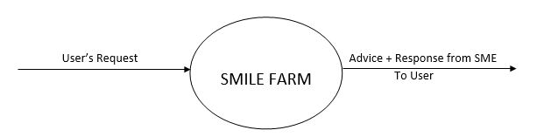
Data Flow Diagram (DFD)[Level-0]
5
T002/ Version 1.0

Slide 6
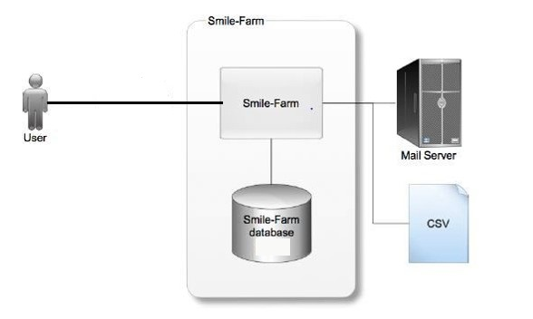
Overall Project Diagram(Flow)
6
T002/ Version 1.0

Slide 7
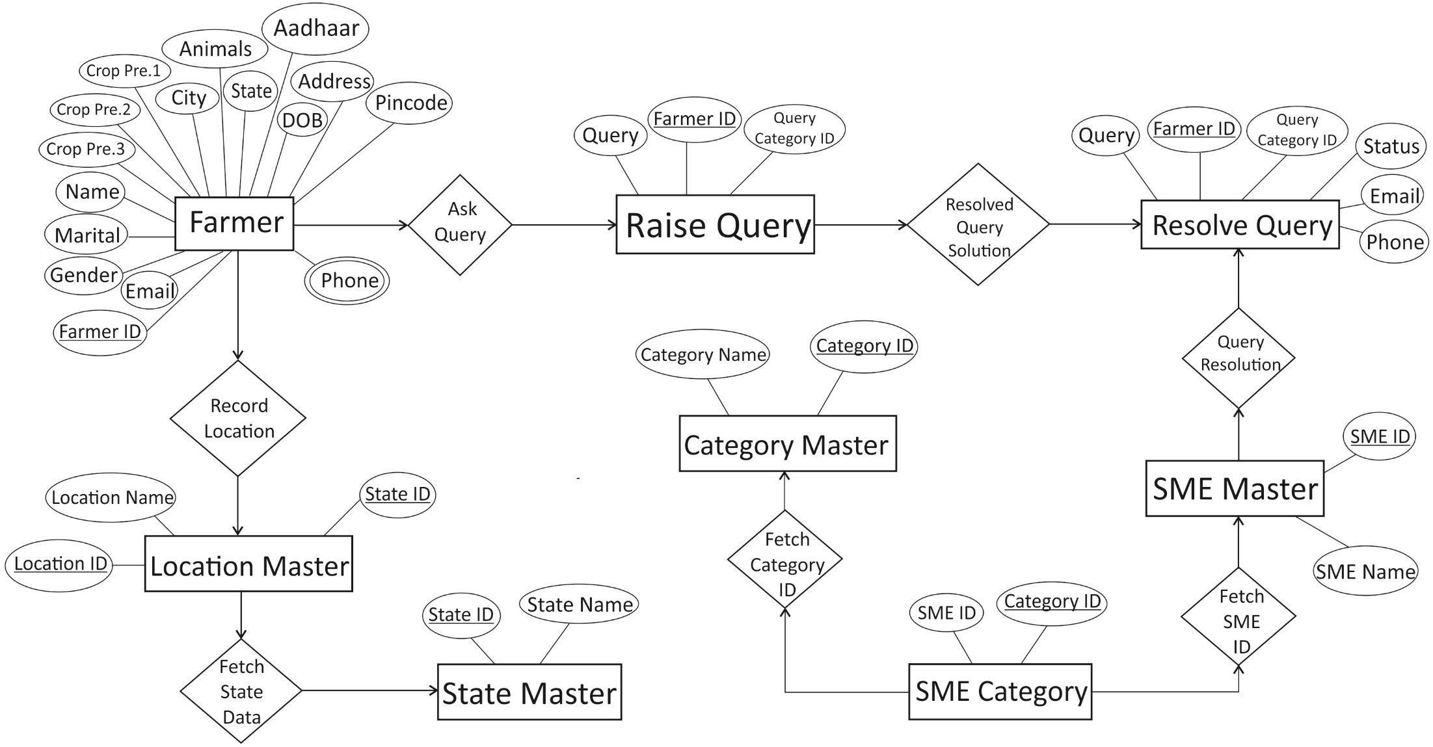
Entity-Relationship Diagram (ERD)
7
T002/ Version 1.0

Slide 8
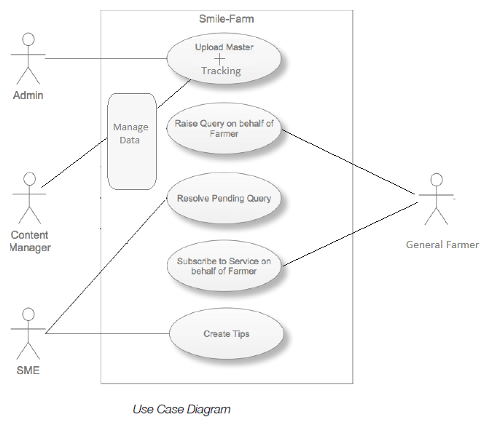
Use Case Diagram
8
T002/ Version 1.0

Slide 9
Advantage of The Project
The main advantages of ‘Smile-Farm’ are as follows:
Raising ‘Awareness’.
Availability and source of latest information in agriculture.
Source of “Valuable Tips” to improve productivity and well-being.
An interactive community for farmers to address their issues and problems.
Farmers can register themselves conveniently to get regular updates.
Provides SMS and E-Mail support to the users.
Providing portability of the whole community to be accessed from anywhere in the world.
9
T002/ Version 1.0

Slide 10
References
Website References:-
https://trailhead.salesforce.com/en
https://www.quora.com/
https://help.salesforce.com/
https://www.youtube.com/
10
T002/ Version 1.0

Slide 11
THANKS
T004/ Version 1.0

